Slide 1

Housing
Server side
Android
Web client
with
Shabab koohi

Slide 2
Who should whatch this course?
Computer Students
Server Side Developers
Android Developers
Front End Developers
Data Science Experts
Generally:
Programming Enthusiasts

Slide 3
Software prerequisites
Java SE Development Kit 7
Apache Maven
IntelliJ IDEA 2016.1
Postgresql+pgAdmin
Android sdk
Gradle
Android Sudio
RestClient(firefox)
Postman(chrome)

Slide 4
Server Side Technologies
Java
Spring boot
Postgresql

Slide 5
Web Client Technologies
HTML
CSS
Bootstrap
AngularJs

Slide 6
Android Technologies
Java
RecyclerView
Webservice
Image caching
volley
Glide

Slide 7
Machine Learning Technologies
Java
Regression
Clustring
weka

Slide 8
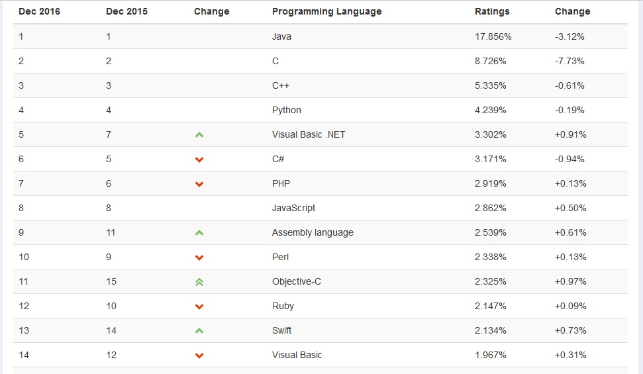
TIOBE Index for December 2016

Slide 9
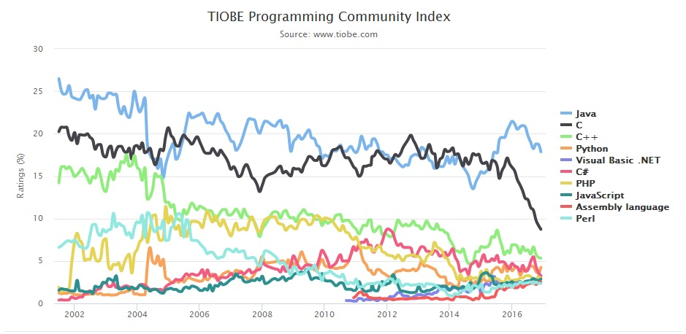
TIOBE Index for December 2016

Slide 10

Other index
Redmonk index: 1 JavaScript 2 Java 3 PHP 4 Python 5 C# 5 C++ 5 Ruby 8 CSS 9 C 10 Objective-C 11 Shell 12 Perl 13 R 14 Scala 15 Go 15 Haskell 17 Swift 18 Matlab 19 Clojure 19 Groovy 19 Visual Basic

Slide 11
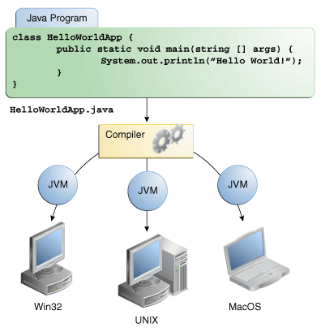
Write once,run everywhere

Slide 12
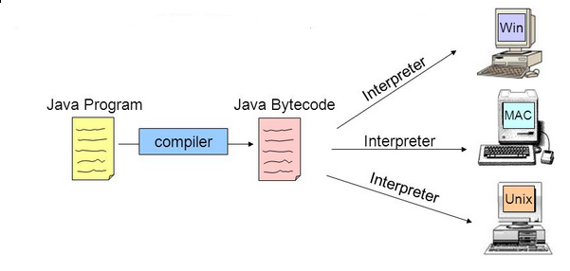
Write once,run everywhere

Slide 13
Java core
HelloWorld
Switch
Static
Loop
Casting
Add library
Exception handling
Collection

Slide 14
OOP
Encapsulation
Inheritance
Abstract
Polymorphism

Slide 15
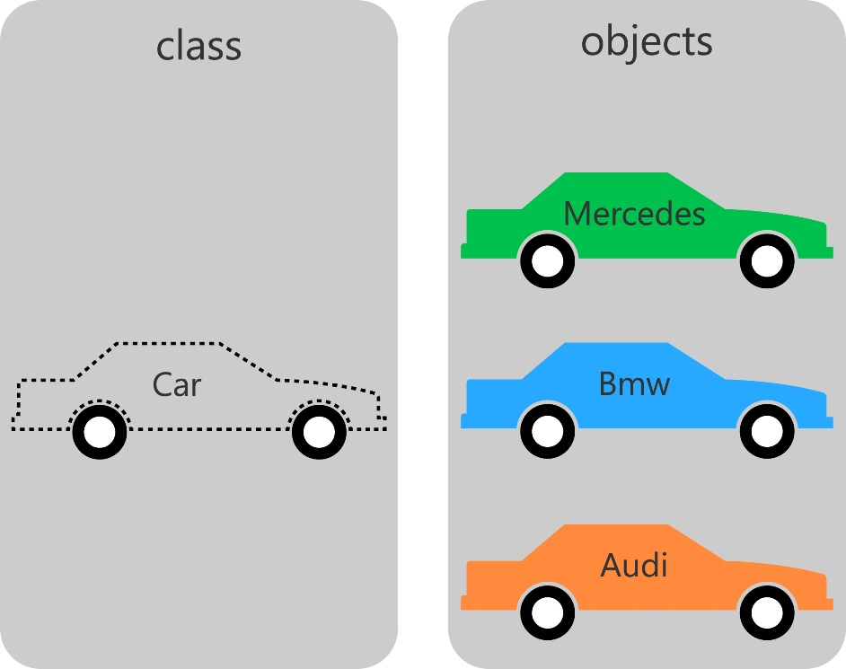
Class
Class is template/blueprint that describes the behavior/state that the object of its type support
A Java program consists of objects from various classes interacting with one another.
A value of a class type is called an object .
Data(field)-Action(method)
Encapsulation (setter -getter)

Slide 16
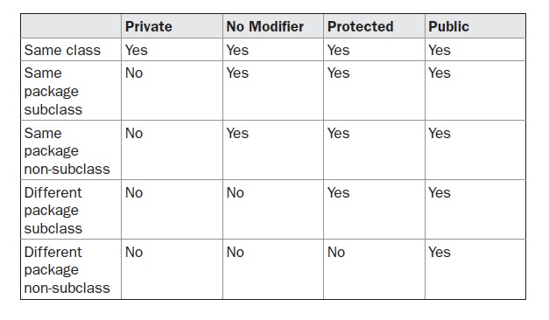
Modifier

Slide 17
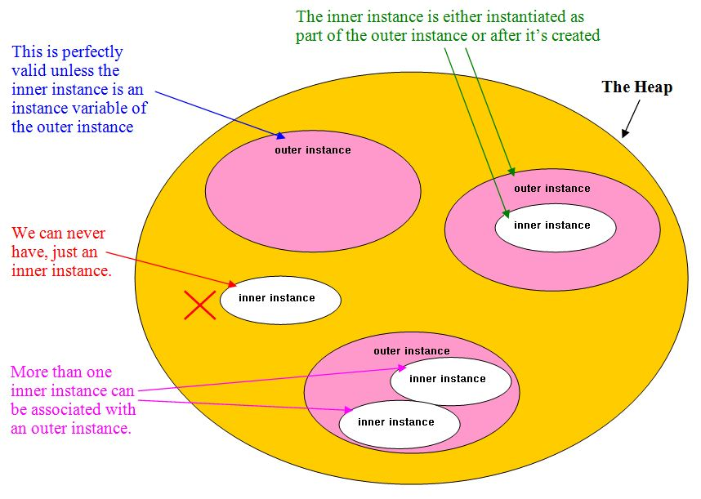
Inner class
Inner classes are classes defined within other classes.
The class that includes the inner class is called an outer class.

Slide 18
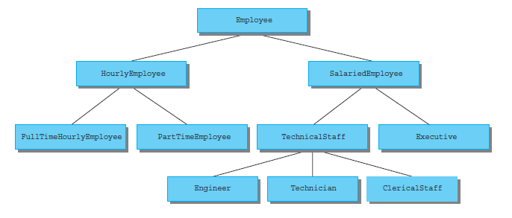
Inheritance
New class—known as a derived class —is created from another class, called the base class.
A derived class is subclass , base class is Superclass.
The subclass inherit the instance variables and methods of the base class that it extends

Slide 19
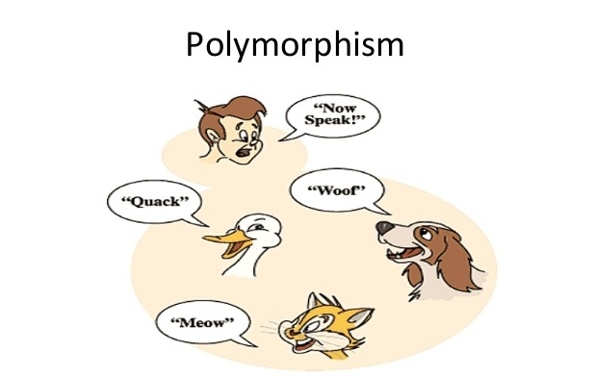
Polymorphism
Make changes in the method definition for the derived classes and to have those changes apply to the software written in the base class.
The most common use of polymorphism in OOP occurs when a parent class reference is used to refer to a child class object

Slide 20
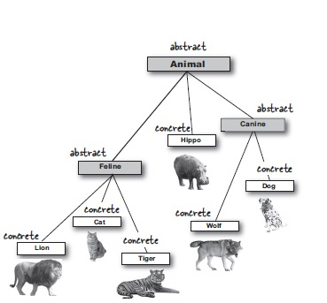
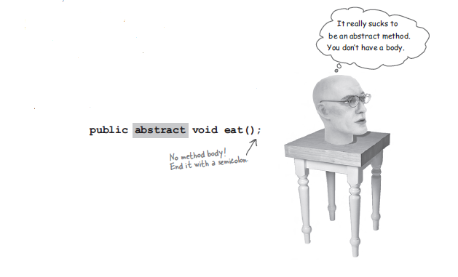
Abstract
Abstraction is a process of hiding the implementation details and showing only functionality to the user.
Abstract method:The method must be overriden.
Abstract class:The compiler won’t let you instantiate
an abstract class.

Slide 21
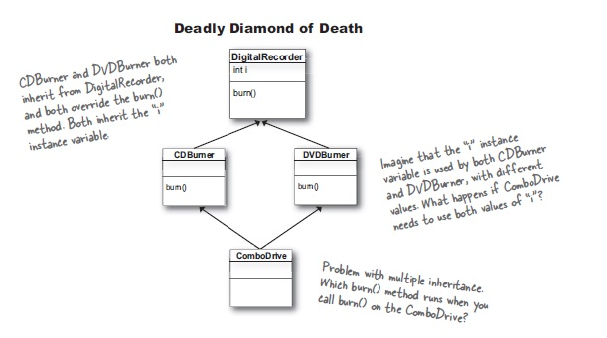
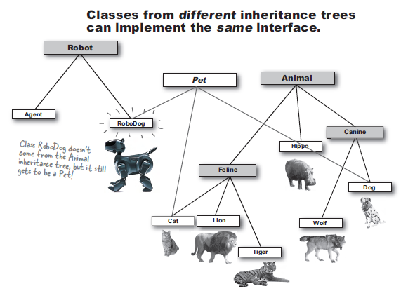
Interface
Like the extreme case of an abstract class.
A java interface solves your multiple inheritence problem.
For methods that must be defined in any class
that implements the interface.

Slide 22
Interface
Like the extreme case of an abstract class.
A java interface solves your multiple inheritence problem.
For methods that must be defined in any class
that implements the interface.

Slide 23
Final Keyword In Java
final Variable:If you make any variable as final, you cannot change the value of final variable(It will be constant).
final method:If you make any method as final, you cannot override it.
final class:If you make any class as final, you cannot extend it.

Slide 24
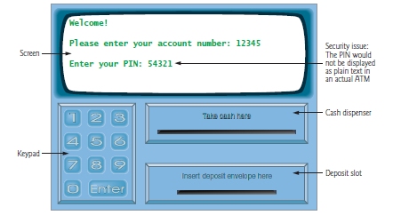
Case Study
(ATM) software system

Slide 25
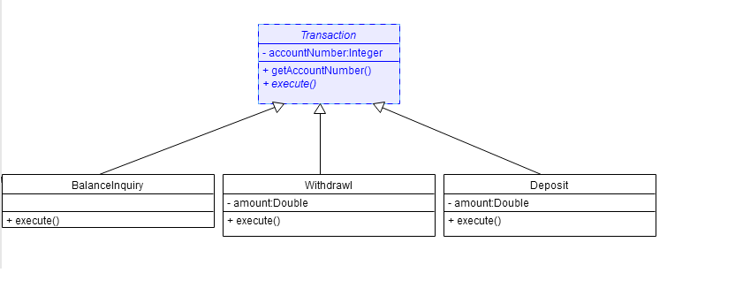
ATM Class Diagram Transaction Inheritance

Slide 26
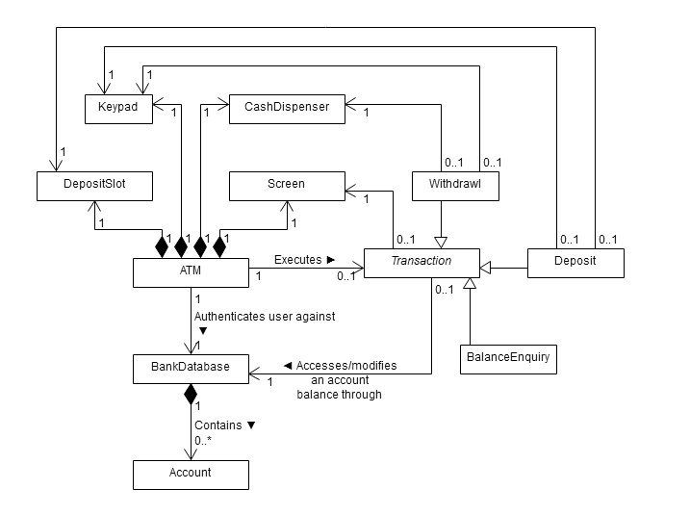
ATM Class Diagram With Inheritance

Slide 27
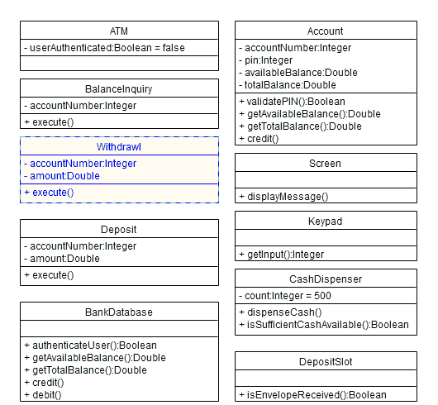
ATM Class Diagram With Visibility Markers

Slide 28
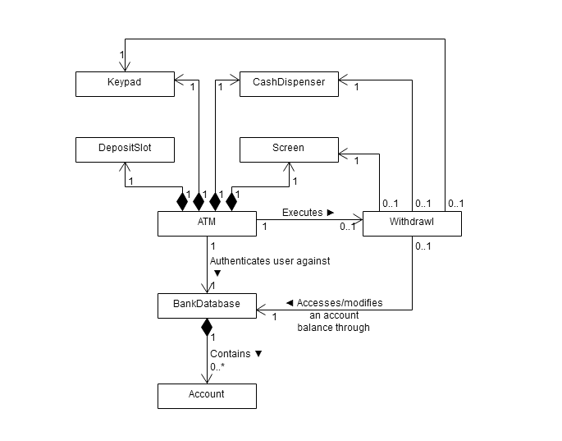
ATM Class Diagrm With Navigability Arrows

Slide 29

Maven
Project management,BuildsDocumentation,Dependencies,Releases,...
Maven simplifies and standardizes the project build process.
groupId:This is an Id of project's group
artifactId:This is an Id of the project
Version:This is the version of the project
com.company.bank:consumer-banking:1.0
com.company.bank:consumer-banking:1.1

Slide 30
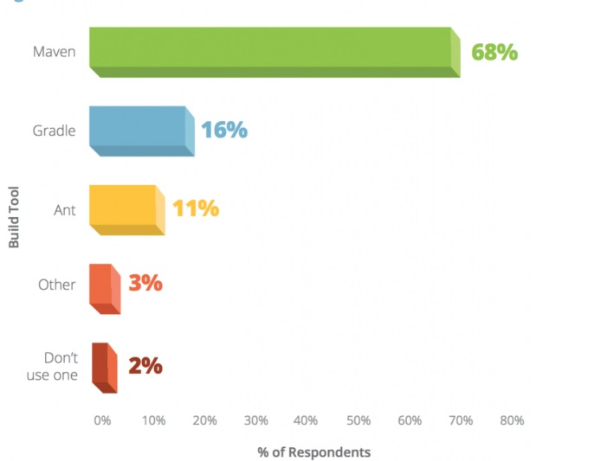
Build tools ranking 2016

Slide 31

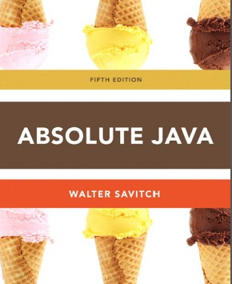
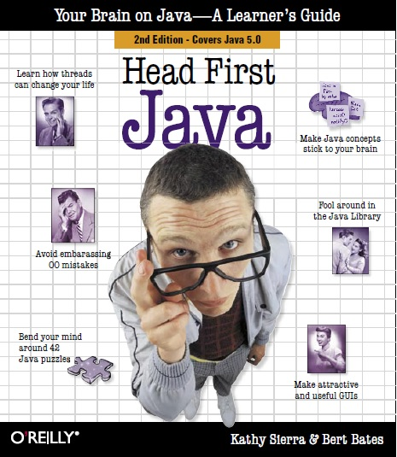

End Of First Day
Refrence:
https://www.ibm.com/developerworks/learn/java/intro-to-java-course/index.html

Slide 32




Second Day

Slide 33
Web service
A web service is a collection of open protocols and standards used for exchanging data between applications or systems.
SOAP based Web Services
RESTful Web Services

Slide 34
RESTful
REST (Representational State Transfer) was introduced and defined in 2000.
web standards based architecture and uses HTTP Protocol for data communication.
Messages use HTTP methods explicitly (for example, GET, POST, PUT, and DELETE).
Representations transfer JSON or XML to represent data objects and attributes

Slide 35
HTTP methods
Use HTTP methods to map CRUD (create, retrieve, update, delete) operations to HTTP requests.
GET:Retrieve information -GET /addresses/1
POST:to create a new entity, but it can also be used to update -POST /addresses
PUT
PATCH
DELETE

Slide 36
HTTP status codes
1XX – informational
2XX – success
3XX – redirection
4XX - client error
5XX - server error

Slide 37
Web service single object response
Listing One: JSON representation of a resource.
{
"ID": "1",
"Name": "M Vaqqas",
"Email": "m.vaqqas@gmail.com",
"Country": "India"
}
Listing Two: XML representation of a resource.
<Person>
<ID>1</ID>
<Name>M Vaqqas</Name>
<Email>m.vaqqas@gmail.com</Email>
<Country>India</Country>
</Person>

Slide 38
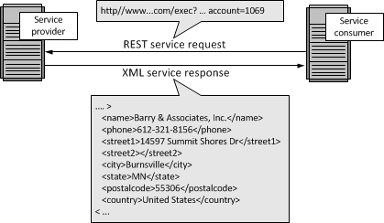
Web service request-response
Sample :
http://api.geonames.org/citiesJSON?north=44.1&south=-9.9&east=-22.4&west=55.2&lang=de&username=demo

Slide 39
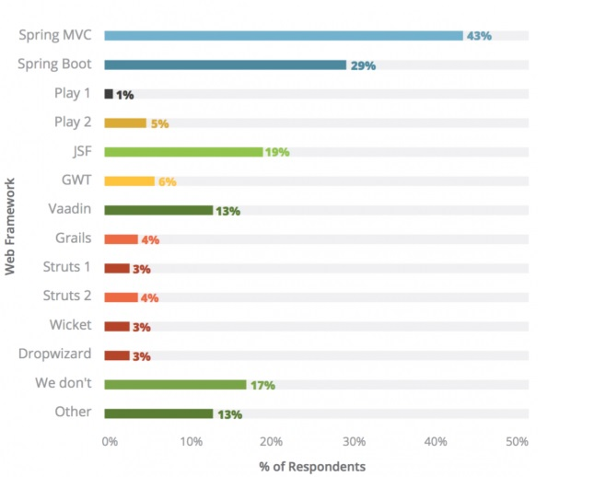
Which Web Frameworks do you use

Slide 40
Spring Framework
Spring is the most popular application development framework for enterprise Java.
Spring is sea
Millions of developers around the world use Spring Framework to create high performing, easily testable, reusable code

Slide 41
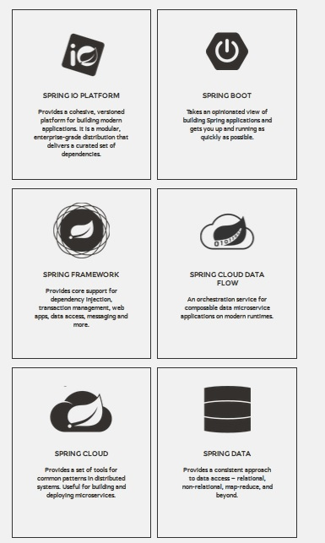
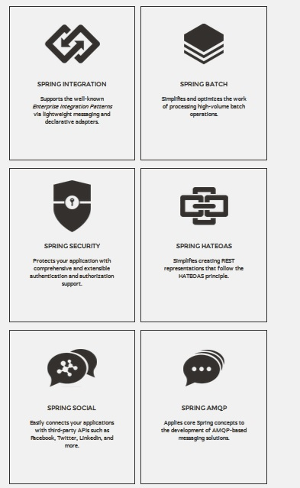
Spring Main Projects

Slide 42
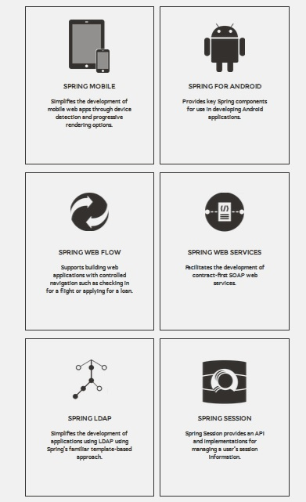
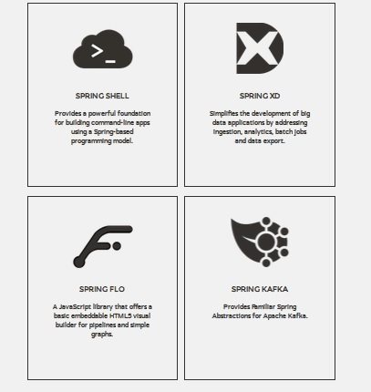
Spring Main Projects

Slide 43
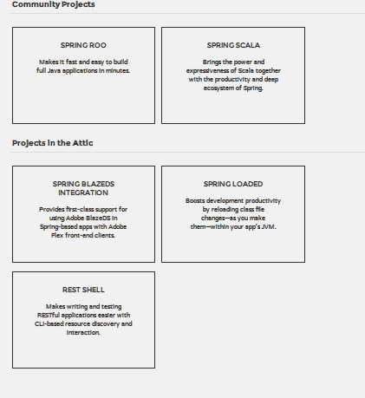
Spring Other Projects

Slide 44

Spring Boot
"just run“
Create stand-alone Spring applications
Embed Tomcat, Jetty or Undertow directly (no need to deploy WAR files)
Provide opinionated 'starter' POMs to simplify your Maven configuration
Automatically configure Spring whenever possible
Provide production-ready features such as metrics, health checks and externalized configuration
Absolutely no code generation and no requirement for XML configuration

Slide 45
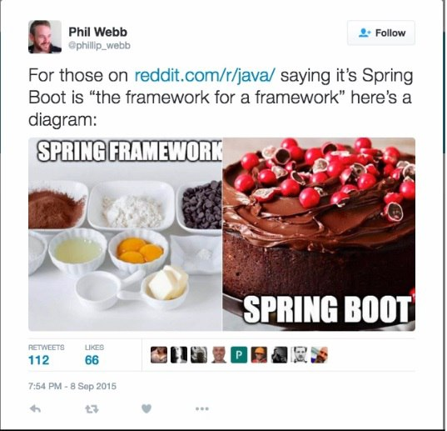

Slide 46
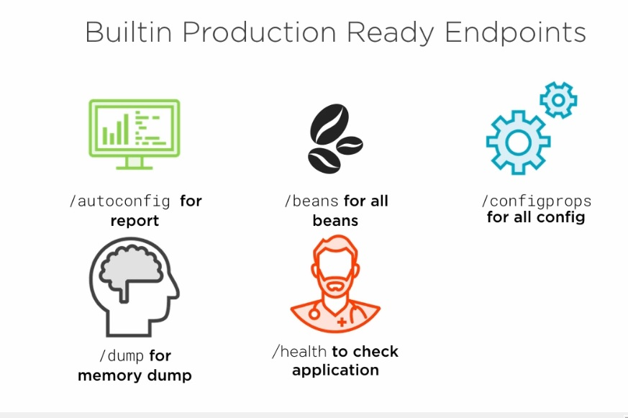
Spring boot monitoring
http://docs.spring.io/spring-boot/docs/current/
reference/html/production-ready-endpoints.html

Slide 47
Machine Learning
A branch of artifi cial intelligence.
we design systems that can learn from data in a manner of being trained.
The systemsmight learn and improve with experience, and with time, refi ne a model that
can be used to predict outcomes of questions based on the previous learning.
Is a type of artificial intelligence whereby an algorithm or method
will extract patterns out of data.

Slide 48
“Hands-On” Means Hands-On
Doing machine learning and learning the theory of machine learning are
two very different subjects. To learn the theory, a good grounding in math is
required. This course discusses a hands-on approach to machine learning. With
the number of machine learning tools available for developers now, the emphasis
is not so much on how these tools work but how you can make these tools
work for you. The hard work has been done, and those who did it deserve to
be credited and applauded.

Slide 49
“But You Need a PhD!”
Personally, I believe that if you’d like to take
a number of years completing a degree, then pursuing the likes of a master’s
degree and then a PhD, you should feel free to go that route. I’m a little more
pragmatic about things and like to get reading and start doing.
For me, though, there’s nothing like getting my hands dirty, grabbing some
data, trying out some methods, and looking at the results. If you need to brush
up on linear regression theory, then let me reassure you now, there’s plenty out
there to read,

Slide 50
Algorithm Types for Machine Learning
Supervised Learning:
Unsupervised Learning:there’s no label or target value given for the data
Reinforcement Learning:figuring out how to play a multistage game with
rewards and payoffs. Think of it as the algorithms that optimize the life of something.
A common example of a reinforcement learning algorithm is a mouse trying to find

Slide 51
Algorithm Types for Machine Learning
Supervised Learning:
Unsupervised Learning:
Reinforcement Learning:figuring out how to play a multistage game with
rewards and payoffs. Think of it as the algorithms that optimize the life of something.
A common example of a reinforcement learning algorithm is a mouse trying to find

Slide 52
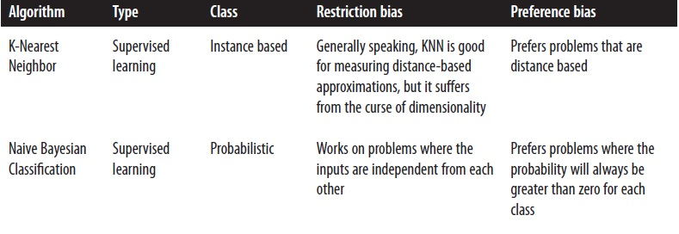
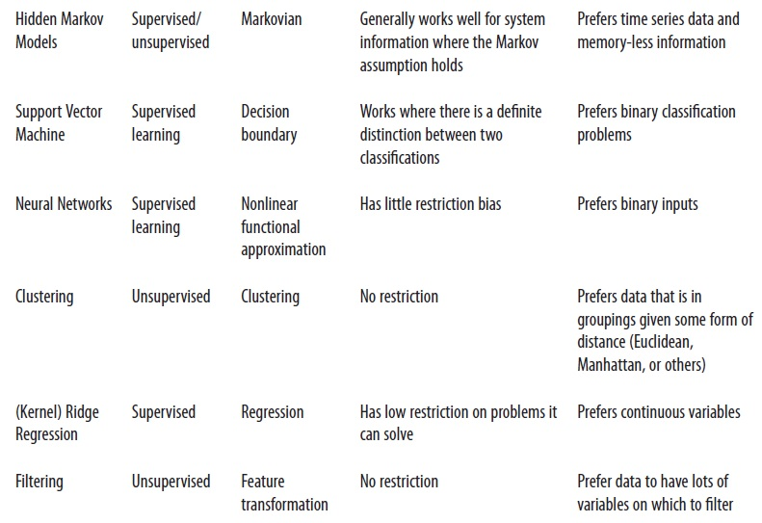
Algorithm Types for Machine Learning

Slide 53
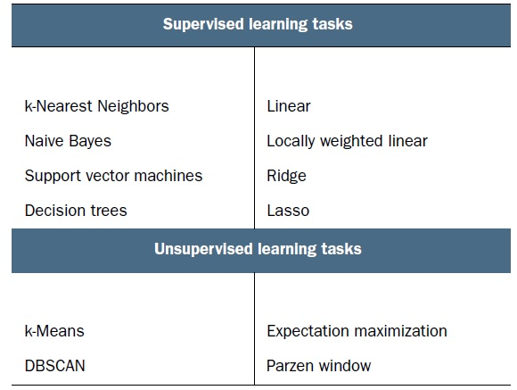
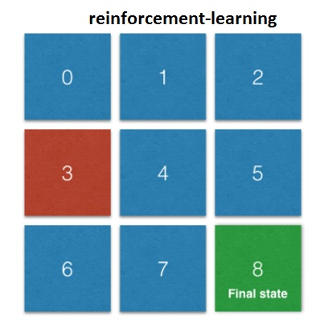
Algorithm Types for Machine Learning

Slide 54
Algorithm Types for Machine Learning
Supervised Learning:The goal here is to learn a model from labeled training data that allows predictions to be made on unseen future data.
Unsupervised Learning:Here we deal with unlabeled data and our goal is to find hidden patterns in this data to extract meaningful information.
Reinforcement:The goal here is to develop a system that improves its performance based on the interactions it has with its environment. This usually involves a reward signal.

Slide 55
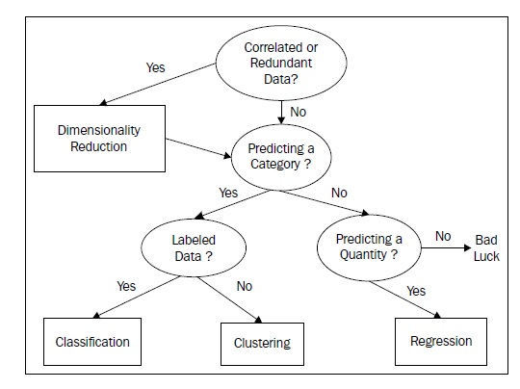
Appropriate task for different machine learning problems

Slide 56
How to choose the right algorithm
If you’re trying to predict or forecast a target value, then you need to look into supervised learning. If not, then unsupervised learning is the place you want to be.
If Yes/No, 1/2/3, A/B/C, or Red/Yellow/Black?-→classification
If the target value can take on a number of values, value from 0.00 to 100.00, or -999 to 999, →regression
Are you trying to fit your data into some discrete groups→clustring
Do you need to have some numericalestimate of how strong the fit is into each group→density estimation algorithm
The rules I’ve given here should point you in the right direction but are notunbreakable laws.

Slide 57
Data Repositories
http://archive.ics.uci.edu/ml/datasets.
www.infochimps.com/datasets
www.kaggle.com/competitions
http://www.kdnuggets.com

Slide 58
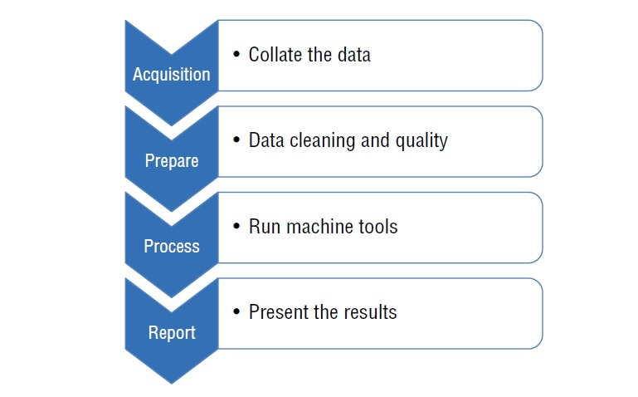
The Machine Learning Cycle

Slide 59
Classification
supervised learning
Classification is about assigning classes to a set of instances, based on their features.
decision trees-support vector machines(svm)
5.5,4.2,1.4,0.2,Iris-setosa
6.3,3.3,6.0,2.5,Iris-virginica
4.9,3.1,1.5,0.1,Iris-setosa
6.4,3.2,4.5,1.5,Iris-versicolor
5.8,2.7,5.1,1.9,Iris-virginica
7.0,3.2,4.7,1.4,Iris-versicolor

Slide 60
Regression
Our goal when using regression is to predict a numeric target value.
Regression is very closely related to classification.
0.17783,0,9.69,0,0.585,5.569,73.5,2.3999,6,391,19,395.77,15.1,17.5
0.22438,0,9.69,0,0.585,6.027,79.7,2.4982,6,391,19,396.9,14.33,16.8
0.06263,0,11.93,0,0.573,6.593,69.1,2.4786,1,273,21,391.99,9.67,22.4
0.04527,0,11.93,0,0.573,6.12,76.7,2.2875,1,273,21,396.9,9.08,20.6
0.06076,0,11.93,0,0.573,6.976,91.0,2.1675,1,273,21,396.9,5.64,23.9
0.10959,0,11.93,0,0.573,6.794,89.3,2.3889,1,273,21,393.45,6.48,22.0
0.04741,0,11.93,0,0.573,6.03,80.8,2.505,1,273,21,396.9,7.88,?

Slide 61
Regression
Our goal when using regression is to predict a numeric target value.
Regression is very closely related to classification.
0.17783,0,9.69,0,0.585,5.569,73.5,2.3999,6,391,19,395.77,15.1,17.5
0.22438,0,9.69,0,0.585,6.027,79.7,2.4982,6,391,19,396.9,14.33,16.8
0.06263,0,11.93,0,0.573,6.593,69.1,2.4786,1,273,21,391.99,9.67,22.4
0.04527,0,11.93,0,0.573,6.12,76.7,2.2875,1,273,21,396.9,9.08,20.6
0.06076,0,11.93,0,0.573,6.976,91.0,2.1675,1,273,21,396.9,5.64,23.9
0.10959,0,11.93,0,0.573,6.794,89.3,2.3889,1,273,21,393.45,6.48,22.0
0.04741,0,11.93,0,0.573,6.03,80.8,2.505,1,273,21,396.9,7.88,?

Slide 62
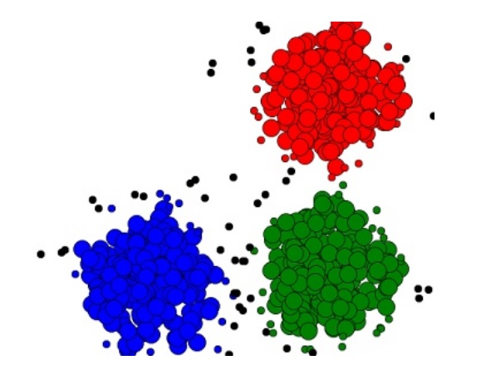
Clustring
most well known unsupervised method.
making a measurement of similarity between instances in an unlabeled dataset.
We often use geometric models to determine the distance between instances,based on their feature values

Slide 63
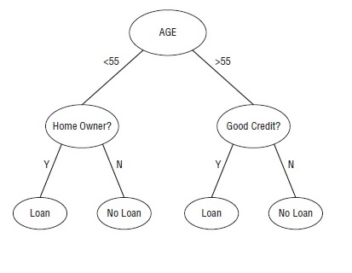
Decision Trees
Supervised learnin.
Predict the value of a target variable based on the set of input variables.
Diff erent Algorithm Types:ID3, C4.5,C5, CHAID, MARS

Slide 64
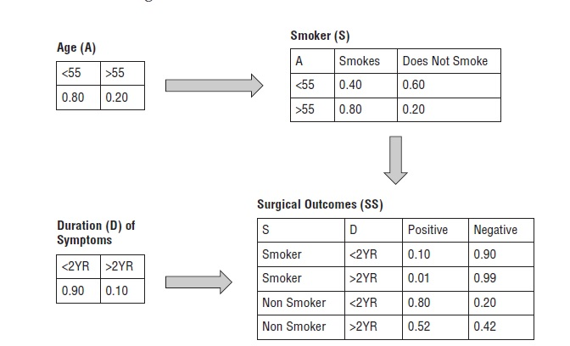
Bayesian Networks
Based on a set of variables or parameters, it’s possible to predict outcomes based on probabilities.
Bayesian Networks are found all over the place where uncertainty is in play which turns out to be a lot of places. Where there is uncertainty, there is probability.
Weather forecasting and stock option, insurance, banking, and investment industries.

Slide 65
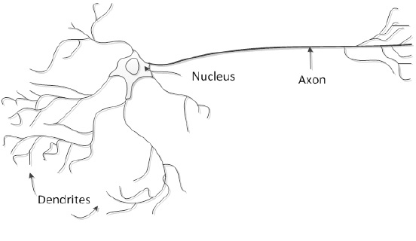
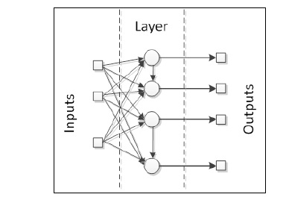
Artifi cial Neural Networks
is a robust function that takes an arbitrary set ofm inputs and fits it to an arbitrary set of outputs that are binary.
inspired by the biological brain.

Slide 66
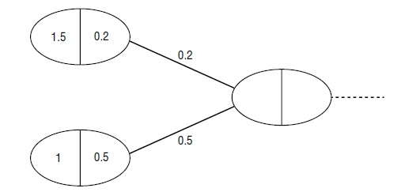
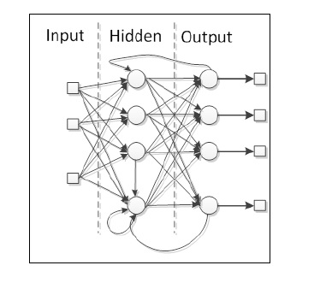
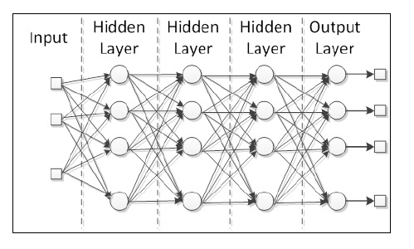
Artifi cial Neural Networks
weight
Feed forward network
Multilayer networks

Slide 67
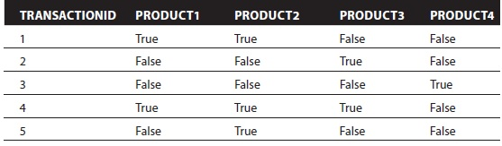
Association Rules Learning
It finds out the interesting connections among elements of the data and the sequence (behaviors) that led up to some correlated result inspired by the biological brain.

Slide 68
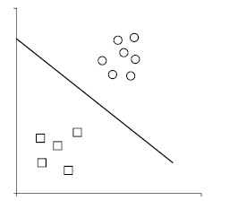
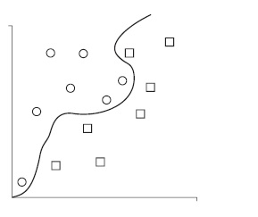
Support Vector Machines(SVM)
technique for classifying objects-supervised learning
classify something into a group that you can then inspect later
dealing with many types of classes.
image recognition and hand-writing pattern recognition.
Medical science has long used support vector machines for protein classification.
Linear classification-Non linear classification

Slide 69
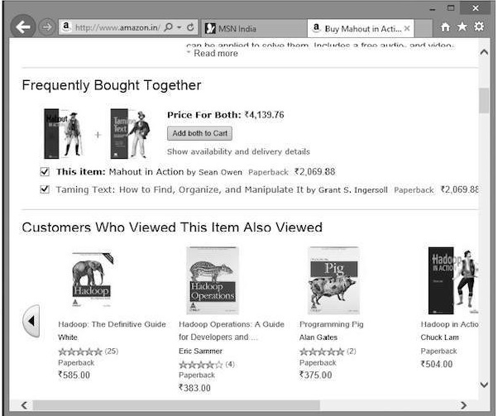
Recommendation Engine
provide recommendations to users based on a variety of patterns, and are helpful in guiding users to consider offerings that they might not otherwise be aware of, based on their specific user habits.
User-based recommendation-Item-based recommendation

Slide 70
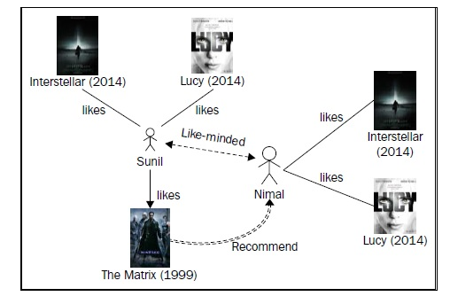
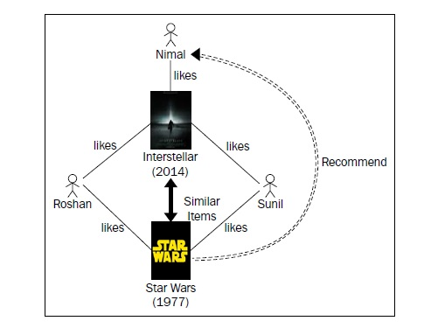
Recommendation Engine
User-based recommendation Item-based recommendation

Slide 71



Machine learning tools

